Slide 1
COA Module 7

Slide 2
Sample questions on last slide

Slide 3
Taxonomy of parallel architectures
SISD
SIMD
MISD
MIMD

Slide 4
Von Neuman Architechture
Historically there have been 2 types of Computers:
Fixed Program Computers – Their function is very specific and they couldn’t be programmed, e.g. Calculators.
Stored Program Computers – These can be programmed to carry out many different tasks, applications are stored on them, hence the name.

Slide 5
Basic Details
The modern computers are based on a stored-program concept introduced by John Von Neumann.
In this stored-program concept, programs and data are stored in a separate storage unit called memories and are treated the same.
This novel idea meant that a computer built with this architecture would be much easier to reprogram.

Slide 6
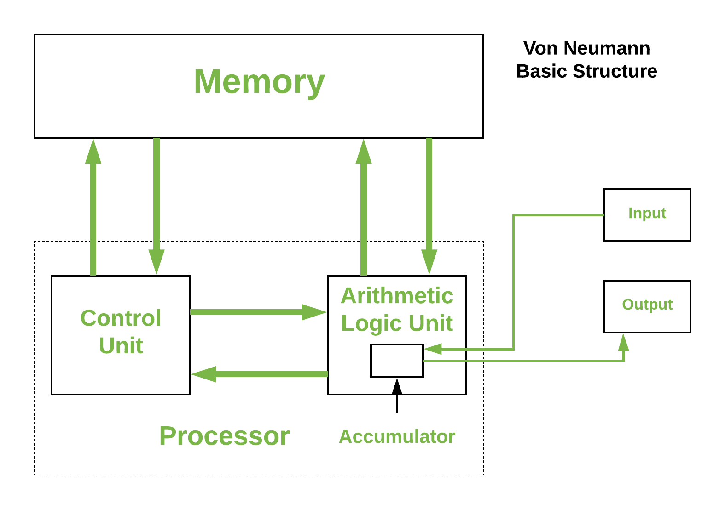
Basic Architecture

Slide 7
It is also known as IAS computer and is having three basic units
The Central Processing Unit (CPU)
The Main Memory Unit
The Input /Output Device
Control Unit –A control unit (CU) handles all processor control signals. It directs all input and output flow, fetches code for instructions and controlling how data moves around the system.
Arithmetic and Logic Unit (ALU) –The arithmetic logic unit is that part of the CPU that handles all the calculations the CPU may need, e.g. Addition, Subtraction, Comparisons. It performs Logical Operations, Bit Shifting Operations, and Arithmetic Operation.

Slide 8
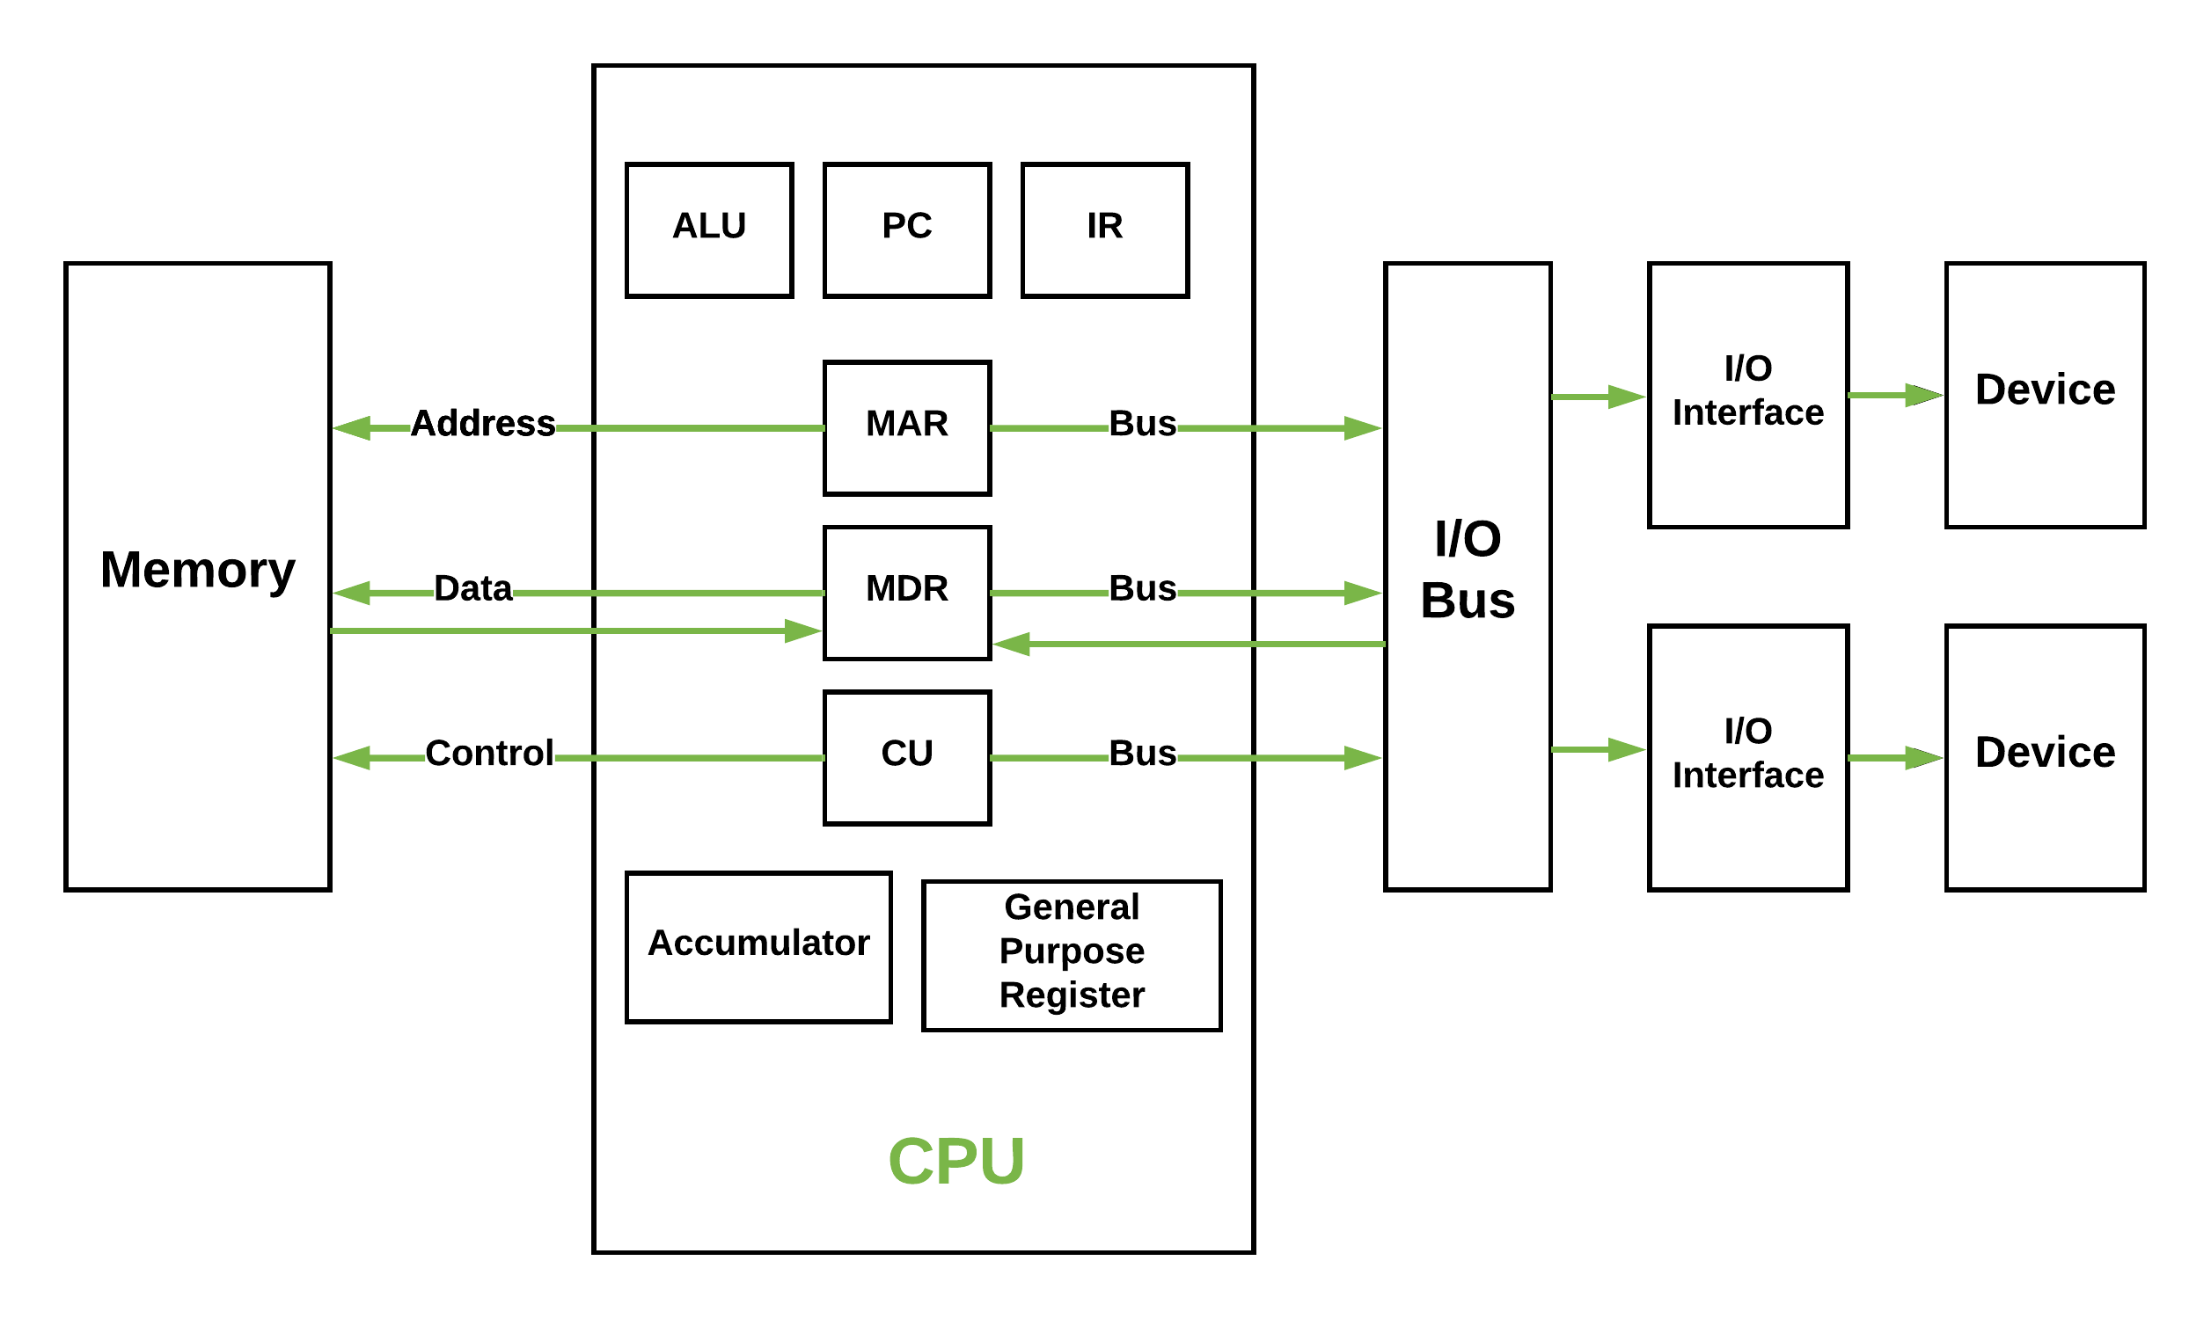
Figure – Basic CPU structure, illustrating ALU

Slide 9
Details
Main Memory Unit (Registers) –Accumulator: Stores the results of calculations made by ALU.
Program Counter (PC): Keeps track of the memory location of the next instructions to be dealt with. The PC then passes this next address to Memory Address Register (MAR).
Memory Address Register (MAR): It stores the memory locations of instructions that need to be fetched from memory or stored into memory.
Memory Data Register (MDR): It stores instructions fetched from memory or any data that is to be transferred to, and stored in, memory.
Current Instruction Register (CIR): It stores the most recently fetched instructions while it is waiting to be coded and executed.
Instruction Buffer Register (IBR): The instruction that is not to be executed immediately is placed in the instruction buffer register IBR.

Slide 10
Basic Details
Input / Output Devices – Program or data is read into main memory from the input device or secondary storage under the control of CPU input instruction. Output devices are used to output the information from a computer. If some results are evaluated by computer and it is stored in the computer, then with the help of output devices, we can present it to the user.
Buses – Data is transmitted from one part of a computer to another, connecting all major internal components to the CPU and memory, by the means of Buses. Types:
Data Bus: It carries data among the memory unit, the I/O devices, and the processor.
Address Bus: It carries the address of data (not the actual data) between memory and processor.
Control Bus: It carries control commands from the CPU (and status signals from other devices) in order to control and coordinate all the activities within the computer.

Slide 11
Von Neumann bottleneck
Whatever we do to enhance performance, we cannot get away from the fact that instructions can only be done one at a time and can only be carried out sequentially.
Both of these factors hold back the competence of the CPU. This is commonly referred to as the ‘Von Neumann bottleneck’.
We can provide a Von Neumann processor with more cache, more RAM, or faster components but if original gains are to be made in CPU performance then an influential inspection needs to take place of CPU configuration.
This architecture is very important and is used in our PCs and even in Super Computers.

Slide 12
Havard Architecture
Harvard Architecture is the digital computer architecture whose design is based on the concept where there are separate storage and separate buses (signal path) for instruction and data.
It was basically developed to overcome the bottleneck of Von Neumann Architecture.

Slide 13
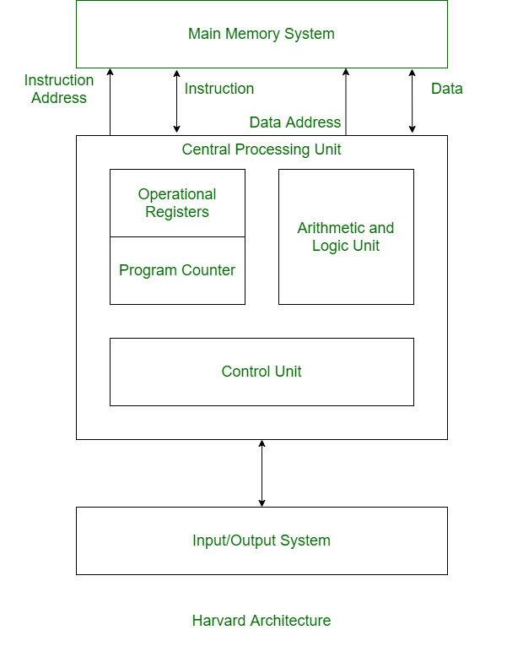

Slide 14
Difference between Von Neumann and Harvard Architecture
VON NEUMANN ARCHITECTURE | HARVARD ARCHITECTURE
It is ancient computer architecture based on stored program computer concept. | It is modern computer architecture based on Harvard Mark I relay based model.
Same physical memory address is used for instructions and data. | Separate physical memory address is used for instructions and data.
There is common bus for data and instruction transfer. | Separate buses are used for transferring data and instruction.
Two clock cycles are required to execute single instruction. | An instruction is executed in a single cycle.
It is cheaper in cost. | It is costly than van neumann architecture.
CPU can not access instructions and read/write at the same time. | CPU can access instructions and read/write at the same time.
It is used in personal computers and small computers. | It is used in micro controllers and signal processing.

Slide 15
Multicomputers
Shared Memory
Distributed Memory

Slide 16
UMA (Uniform memory access)
In this model, all the processors share the physical memory uniformly. All the processors have equal access time to all the memory words. Each processor may have a private cache memory. Same rule is followed for peripheral devices.
When all the processors have equal access to all the peripheral devices, the system is called a symmetric multiprocessor. When only one or a few processors can access the peripheral devices, the system is called an asymmetric multiprocessor.

Slide 17
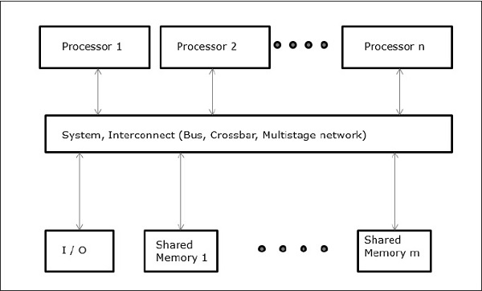
UMA

Slide 18
Non-uniform Memory Access (NUMA)
In NUMA multiprocessor model, the access time varies with the location of the memory word. Here, the shared memory is physically distributed among all the processors, called local memories. The collection of all local memories forms a global address space which can be accessed by all the processors.

Slide 19
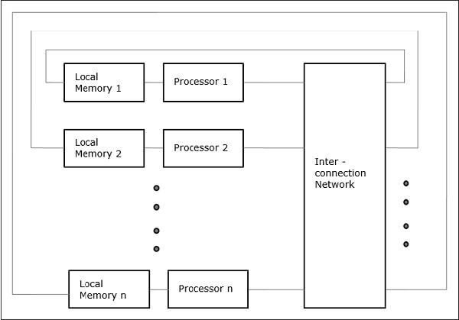
NUMA

Slide 20
Cache Only Memory Architecture (COMA)
The COMA model is a special case of the NUMA model.
Here, all the distributed main memories are converted to cache memories.

Slide 21
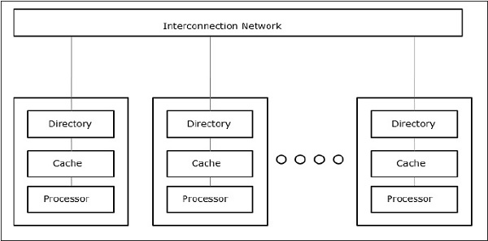
COMA

Slide 22
Distributed - Memory Multicomputers
A distributed memory multicomputer system consists of multiple computers, known as nodes, inter-connected by message passing network. Each node acts as an autonomous computer having a processor, a local memory and sometimes I/O devices. In this case, all local memories are private and are accessible only to the local processors.
This is why, the traditional machines are called no-remote-memory-access (NORMA) machines.

Slide 23
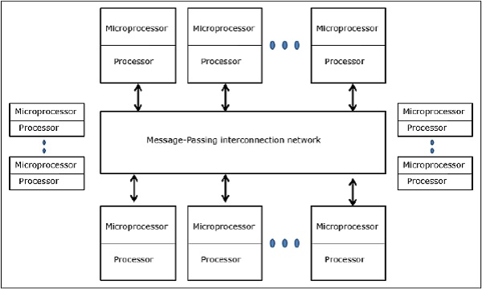
Distributed Memory Architecture

Slide 24
Discuss COMA and NUMA model.
Analyze cache coherence problem
Write a short note on hypercube and mesh connected network.
Illustrate parallel computer
Demonstrate SISD, SIMD, MISD, MIMD models of parallel computers.
Sketch loosely and tightly coupled multi processor system
Demonstrate multiprocessor system. Explain How does it differ from a multicomputer system?
Evaluate tightly coupled versus loosely coupled system.
Describe with proper diagram the working principle of a crossbar switch interconnection network. Draw the basic block diagram of a crossbar switch used in the network.
Express the meaning of cache coherence problem in multiprocessor unit. State the possible solutions to the problem.
"Point out the meaning of tightly coupled & loosely coupled systems
Compare & contrast between UMA & NUMA.
"

Slide 25
Thank You!!

